Slide 1

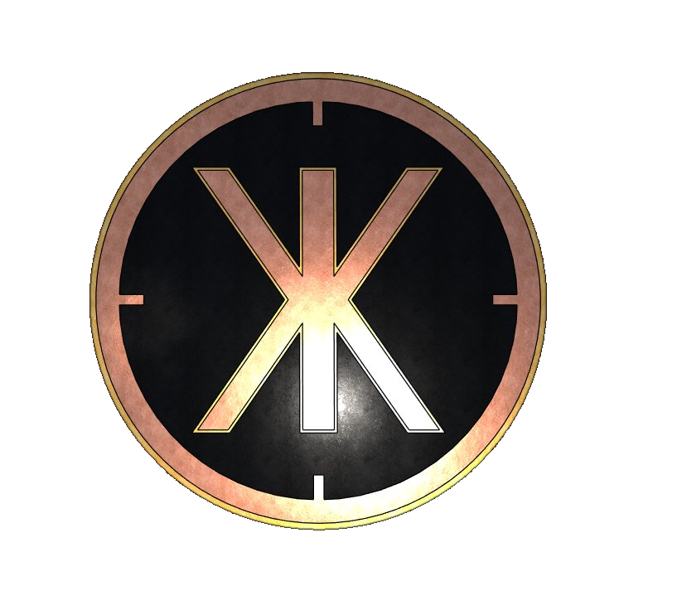
umpireal
Traffic Congestion
The Energy Blackhole
Of The Modern World
Stop Start Traffic Wastes Up To 5,000 TWH Of Energy Per Year Globally In Comparison The Entire World's Nuclear Power Station Fleet Produces Roughly 2,600 TWH Per Year.
Notes:
Understanding the vision and mission behind URSA MAJOR is vital to appreciating its innovative approach. We will also meet Alan Ledwith, the inventor, and consider the current challenges faced at traditional crossings and ramps.

Slide 2
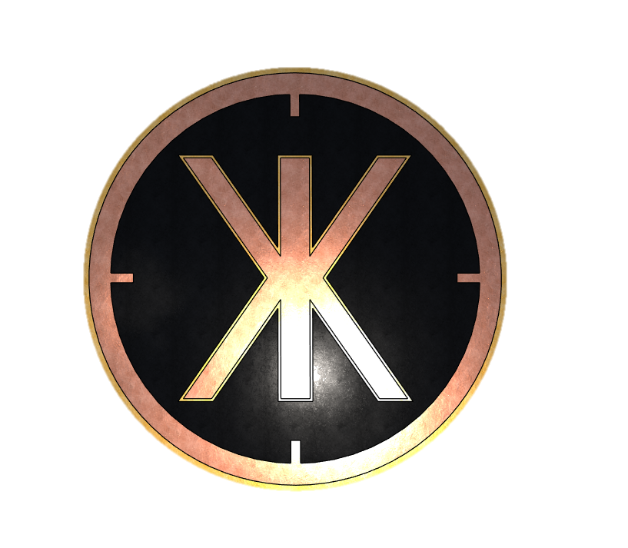
umpireal
Business Model 1: Umpireal House of Data
Traffic Flow Preservation with Integrated Real Estate: Sovereign AI Edge Infrastructure · IBM + NVIDIA + BYD · 8 GWh Energy Offset Per Node
INVESTOR PRESENTATION · APRIL 2026
Stop-start driving forces cars to burn 67% more fuel at every junction—while for HGVs, that waste spikes to 87%. This massive energy leak heats our cities, drains logistics fleets, and overloads the grid. For decades, this has been an overlooked “stopping tax" on urban motion.
NODE CAPEX
YR 1 EBITDA
PAYBACK
20-YR EBITDA
€5.79M
€2.58M
~ 32 months
~ €240M
ex racks + grid
87.2% EBITDA · €2.24M net to SPV · standard 4-rack node
4 racks standard · scales to flagship
~24×Per Node
UMPIREAL · CONFIDENTIAL
www.umpireal.com · IP Filing: 2025/0540 · Alan Ledwith, Founder

Slide 3
THE PROBLEM
Every Junction Is a Net Energy Burden
PENALTY 1 — BRAKE HEAT
PENALTY 2 — RE-ACCELERATION
When a vehicle stops at a junction, kinetic energy built up by the engine is converted entirely to brake heat and friction. It enters the urban atmosphere as waste heat. It cannot be recovered. It is simply gone.
The engine then re-accelerates from standstill at its lowest efficiency point — burning maximum fuel to restore the momentum that was just discarded. This is the most expensive moment in any journey.
Cars burn
HGVs burn
Wasted energy
CO₂ emitted
67% MORE FUEL
87% MORE FUEL
8 GWh / yr
2,000 t / yr
at every stop vs cruising
at every stop vs cruising
per busy junction
per junction — needlessly
Or 1.1 Million m3 of CO₂
For 30 years, Euro 1 to Euro 6 policy improved engines. Nobody applied a single standard to the road itself. The junction stayed broken. UMPIREAL is a leap to euro 10 in one bound.
UMPIREAL · CONFIDENTIAL
01 — The Problem

Slide 4
THE SOLUTION
THE BÉAR CROSSING
The BÉAR Crossing is a road junction geometry that routes pedestrians safely underneath the road so vehicles never stop. No stopping = no kinetic energy lost to brake heat. No re-acceleration from standstill. No urban heat pulse.
TRAFFIC
PEDESTRIANS
REAL ESTATE
Vehicles never stop
Cross safely underneath
Space created below
Traffic preserves momentum through the junction. Stop-start friction is permanently eliminated. Every vehicle, every crossing, every day.
A dedicated pedestrian underpass runs beneath the raised road. Full DDA compliance, lighting, wayfinding. Safer than a surface crossing at any traffic speed.
The geometry creates enclosed, structurally sound, weatherproof space beneath the crest. Modular, scalable, deployable at any junction. The road pays for the building.
This is not carbon capture. There is nothing to capture — because thanks to Umpireal, it was never burned.
UMPIREAL · CONFIDENTIAL
02 — The Solution

Slide 5
THE NODE
What Lives Beneath the Road
Standard node: 9 rooms · 620 m² technical + 180 m² hospitality · single 500 kW commercial grid connection · shell built to flagship structural spec throughout.
Room 1
Room 2
Room 3
Room 4
Room 5
DATA CENTRE
BESS STORAGE
M&E PLANT
BACKUP / FLEX
COMMERCIAL / CIVIC
4 × NVIDIA VR NVL72 (Vera Rubin)
288 GPUs · 14.4 EFLOPS FP4
460 kW IT load · 7 racks total
Direct liquid cooled — 190 kW/rack
Fabric + DPU + mgmt racks included
Scales to 8, 16, 32 racks — no rebuild
BYD Blade LFP · 7MWh · 1 room
7 MWh · 3.5 MW · LFP chemistry
Grid services + arbitrage
€280–420K/yr grid services
CDUs · pump sets
Plate heat exchangers
LV switchgear · UPS
500 kW grid connection
ATS · generator stub
Future BESS string
or commercial let
rough-in pre-installed
Café · fast food restaurant
EV fast charging
Co-working / NOC
Retail · office · civic space
High-footfall location
STRUCTURAL SHELL 9-room node · 620 m² technical · 180 m² hospitality · Design life: 100+ years · Slab-on-grade: 1,875 kg/m² VR NVL72 rated · Upgrades to 8/16/32 racks require no structural changes
UMPIREAL · CONFIDENTIAL
03 — The Node

Slide 6
CAPITAL COST
€5.79M Colocation Tenant Ready
BREAKDOWN
VS CONVENTIONAL DC
Structural shell (precast + install + civils)
€1.89M
33%
Conventional build
€41–46M
Above-ground road works + civils + TM
€0.8M
9%
Source: Savills Ireland / Turner &
Townsend 2023 · €8.4–10M/MW
Includes: land, shell, electrical,
HVAC, cooling, fire, fitout
Data room fit-out — DLC-ready, IaaS landlord scope (4× NVL72)
€1.04M
18%
BESS — 7MWh BYD Blade LFP · 1 room (€120/kWh installed)
€0.975M
17%
Umpireal node
Cooling + M&E plant + backup power
€0.530M
9%
€5.79M
Hospitality + commercial tenancy fit-out
€0.472M
8%
Includes road, ramps, utilities,
BESS, district heating, security
and traffic monitoring
Professional fees + contingency (18%)
€0.884M
15%
TOTAL NODE CAPEX (ex NVL72 racks + grid)
€5.79M
86% CHEAPER — MORE CAPACITY
UMPIREAL · CONFIDENTIAL
04 — Capital Cost

Slide 7
REVENUE MODEL
Four Uncorrelated Revenue Streams
1 — COLOCATION
92% EBITDA
2 — BESS GRID SERVICES
High margin
€2.0–2.5M/yr
€280–420K/yr
$500/kW/mo · 4 × VR NVL72 · 460 kW · 80% occ.
Conservative: €280K · Upside: €420K
Tenant brings own GB200 racks. Umpireal sells conditioned space, power and liquid cooling. Energy is a pass-through. No rack capex, no depreciation, no utilisation risk.
Arbitrage (€2.5–3.5M) + Frequency Response FCR/aFRR (€3.0–4.5M) + Capacity Market (€0.5–1.0M). The 3.5 MW / 7 MWh BYD Blade LFP node qualifies for high-value Primary Frequency Response contracts. LFP chemistry ideal for enclosed underground deployment.
3 — DISTRICT HEATING
Pure upside
4 — CARBON CREDITS
Attributable
€102K/yr
€104K/yr
~260 homes · 2.6 GWh thermal · GPU waste heat
2,088 t CO₂ offset · EU ETS @ €50/t
GPU liquid cooling waste heat recovered and exported to local district heating network. At 460 kW IT load, ~260 homes served. Scales with each rack upgrade.
The fuel not burned at the junction (2,000 t) plus grid carbon displaced by BESS (88 t) = 2,088 t of attributable CO₂ offset per node per year at standard configuration.
Plus: IP licence fee €160K (yr 1) · Commercial tenancy €150K/yr · EV charging €30K/yr · Node upgrades to 8/16 racks add proportional colocation revenue on same infrastructure
UMPIREAL · CONFIDENTIAL
05 — Revenue Model

Slide 8
P&L SUMMARY
Year 1 P&L — Colocation Model
REVENUE
Colocation IaaS (460 kW · $500/kW/mo · 80% occupancy · 4 × VR NVL72)
€2.01M
BESS grid services + arbitrage (7MWh BYD Blade · conservative)
€350K
District heating (~260 homes, 2.6 GWh thermal)
€102K
EU ETS carbon credits (2,088 t @ €50/t)
€104K
Hospitality + tenancy + EV charging + IP licence (yr 1)
€390K
TOTAL GROSS REVENUE
€2.956M
COSTS
Energy + IT rack capex (pass-through / tenant-owned — zero net cost)
€0
Node opex (maintenance, insurance, monitoring staff)
€380K
EBITDA (pre-distribution)
€2.576M
87.1%
Ground rent to council (€250/m² × 770m²)
−€193K
Commercial rates (council levy)
−€150K
Net to Umpireal SPV
€2.233M
UMPIREAL · CONFIDENTIAL
06 — P&L Summary

Slide 9
20-YEAR MODEL
Three Upgrade Cycles. Compounding Returns.
YEAR 3 — RUBIN ULTRA NVL576
YEAR 7 — FEYNMAN GENERATION
YEAR 12 — GEN 5 + BESS REFRESH
+25% colocation rate · tenant upgrades to Rubin Ultra · 600kW/rack · operator uplifts rent
+20% colocation rate · Feynman generation · same shell · new compute standard
+20% rate · BESS modules €1.9M · enclosures/switchgear kept
Yr | Colo Rev | Ancillary | Total Rev | Opex | BESS Rep. | EBITDA | Margin | Cumulative
1 | €2.01M | €0.56M | €2.57M | €0.55M | — | €2.58M | 85% | €2M
2 | €2.07M | €0.58M | €2.65M | €0.39M | — | €2.26M | 85% | €5M
3 | €4.14M | €0.60M | €4.74M | €0.42M | — | €4.32M | 95% | €11M
5 | €8.28M | €0.64M | €8.92M | €0.48M | — | €8.44M | 95% | €29M
7 | €9.94M | €0.68M | €10.62M | €0.51M | — | €10.11M | 95% | €48M
10 | €19.9M | €0.74M | €20.6M | €0.55M | — | €20.1M | 95% | €93M
12 | €20.5M | €0.79M | €21.3M | €0.58M | €1.9M | €18.8M | 88% | €134M
15 | €24.6M | €0.86M | €25.5M | €0.64M | — | €24.8M | 97% | €203M
20 | €26.0M | €1.00M | €27.0M | €0.74M | — | €28.8M | 97% | ~€240M
Yr 1 EBITDA
Yr 20 EBITDA
Cumulative 20yr
MOIC on node
€2.58M
€28.8M
~€240M
~24×
UMPIREAL · CONFIDENTIAL
07 — 20-Year Model
★ = rack upgrade year

Slide 10
DEPRECIATION
The Shell Is Permanent.
The Technology Is a Subscription.
Asset | Cost | Life | Annual Depr. | Risk | Cycle
Precast shell + structural civils | €2.1M | 120 yrs | €9,600/yr | Negligible | Never — design life outlasts all technology
Above-ground road works | €0.8M | 30 yrs | €47,000/yr | Very low | Yr 30 — standard road maintenance cycle
Data room fitout | €1.0M | 20 yrs | €50,000/yr | Low | Yr 20 — outlasts 5+ rack generations
BESS — 7MWh BYD Blade LFP (2 rooms) | €1.9M | 12 yrs | €158,000/yr | Medium | Yr 12 — modules €1.9M, keep enclosures & switchgear
Cooling + district heating | €0.7M | 20 yrs | €35,000/yr | Low | Yr 20 — alongside data room fitout
Monitoring + security | €0.9M | 10 yrs | €90,000/yr | Low | Yr 10 — technology refresh €0.30M
IT racks VR NVL72 (Vera Rubin) | €0 to operator | 3–4 yrs | €0 to operator | Zero | Tenant owns, depreciates and replaces
BLENDED OPERATOR DEPRECIATION (years 1–5)
~€503K/yr
5.4% of capex/yr — extraordinarily low for an asset generating 95%+ EBITDA margins. After year 5, blended depreciation drops to ~€413K/yr as soft costs fully amortise.
VR NVL72 STRUCTURAL ADVANTAGE Each VR NVL72 rack uses the same Oberon rack architecture as GB300 — same footprint, same 1,875 kg/m² floor load, now with direct liquid cooling. The Umpireal precast slab-on-grade shell supports this load natively. 80% reduction in rack airflow vs GB300 means lower ventilation infrastructure cost. The building improves with every compute generation — the shell never needs modification.
UMPIREAL · CONFIDENTIAL
08 — Depreciation

Slide 11
STRUCTURAL VALIDATION
BS 8004 Compensated Foundation Analysis
Component | Basis | kN/m²
Section 1 — Gross loads at base (77 m² floor area)
Precast shell 75 m³ @ 24.5 kN/m³ ÷ 77 m² | Dead | 23.9
32 × VR NVL72 racks 49,700 kg ÷ 77 m² | Dead | 6.3
Road formation 600 mm avg 21 kN/m³ | Dead | 12.6
Hardcore 300 mm crushed stone 20 kN/m³ | Dead | 6.0
100 t live traffic 2 × 44t HGVs, direct on roof slab | Live | 13.0
Gross total at base |  | 61.8
Section 2 — Excavation credit (qₙᵤ = qᵤ − γDf)
Soil displacement credit 2.3 m × 1.9 t/m³ × 9.81 = 42.8 kN/m² | BS 8004 γDf | −43.0
Net bearing pressure at foundation level |  | 18.8
Section 3 — Load dispersion to subgrade
200 mm XPS rigid board — negligible spread | — | —
50 mm fines φ = 25°, spread = 23 mm each side | φ = 25° | —
300 mm hardcore 3" down φ = 45°, spread = 300 mm each side | φ = 45° | —
Dispersed area at subgrade (10.0 + 0.60) × (7.7 + 0.60) = 87.98 m² | Area | 87.98 m²
Net bearing pressure at subgrade — 18.8 × 77 ÷ 87.98 |  | 16.5 kN/m²
Section 4 — BS 8004 bearing capacity check (net allowable vs 16.5 kN/m²)
UMPIREAL · CONFIDENTIAL
09 — Structural Validation

Slide 12
STRUCTURAL VALIDATION part 2
BS 8004 Bearing Capacity — Ground Type Check
Ground type | BS 8004 net allowable | Safety factor | Status
Dense gravel / sand-gravel | 600 kN/m² | 36.4× | Pass
Stiff boulder clay | 300 kN/m² | 18.2× | Pass
Stiff clay | 150 kN/m² | 9.1× | Pass
Firm clay | 75 kN/m² | 4.5× | Pass
Soft clay | 40 kN/m² | 2.4× | Ground improvement
Very soft clay / made ground | <25 kN/m² | <1.5× | Not suitable
The BEAR Crossing colocation model is structurally and geotechnically viable. The compensated foundation principle confirms that the node imposes similar net loads to the road it sits beneath. Any challenges that arise beyond this will be site-specific and resolved through standard civil engineering practice.
UMPIREAL · CONFIDENTIAL
09b — Bearing Capacity

Slide 13
PUBLIC BENEFIT
8 GWh Preserved. 2,000 Tonnes Avoided.
Per Junction. Per Year.
8 GWh
2,000 t
€1.80M
Fuel energy preserved
CO₂ avoided
Fleet fuel saving
Stays in tanks — never burned
Equivalent to planting
200,000 trees/yr
~900,000 litres @ €2.00/L
60,833 hrs
1.34 GWh
~280 homes
Commuter time saved
Urban heat not generated
District heating served
€1.09M/yr value @ €18/hr
Junction heat pulse eliminated
GPU waste heat recovered
Umpireal is the Euro 10 for road infrastructure — skipping straight from zero performance standard to best-in-class in a single move. Every junction is a policy gap. Every BÉAR Crossing closes it.
UMPIREAL · CONFIDENTIAL
09 — Public Benefit

Slide 14
STRATEGIC PARTNERS
IBM + NVIDIA + BYD — The Three-Layer Stack
At 1,000 nodes: IBM + NVIDIA deploy sovereign AI at urban scale · BYD ships €1.05T of VR NVL72 compute. BYD ships €1.9B of BESS units. Addressable market: ~5 million viable junctions globally.
NVIDIA
BYD ENERGY STORAGE
VR NVL72 (Vera Rubin) · 32 racks per node · 6,080 kW · IBM watsonx + Red Hat AI Factory
Blade LFP · 7MWh per node · 2 rooms · €1.9M per node · safest chemistry for enclosed nodes
Why NVIDIA + IBM:
· The GB200 needs liquid cooling — 95% of buildings can't support it
· Umpireal is 80% cheaper per MW than conventional DC build
· IBM Sovereign Core + VR NVL72 = regulated AI that never leaves the jurisdiction
· Slab-on-grade shell natively supports 1,875 kg/m² rack load
What we want:
IBM Ventures co-investment · VR NVL72 preferred partner
Joint pilot node · Metropolis / sovereign AI introductions
Why BYD:
· Blade LFP — safest chemistry for enclosed underground nodes (nail penetration certified)
· Urban road infrastructure = new channel BYD doesn't have
· 7MWh per node · 3.5MW · 6,000+ cycle life — ideal for high-frequency grid services
· BYD operates in 70+ countries — accelerates global rollout
What we want:
Preferred partner + volume pricing · Joint pilot node
Volume pricing · Joint pilot node · Access to BYD's 70-country government/utility network
UMPIREAL · CONFIDENTIAL
10 — Strategic Partners

Slide 15
COMMERCIAL USES
The Under-Crest Space — Configured to Location
The BÉAR Crossing creates enclosed, structurally sound real estate at every junction. The configuration is entirely location-driven — from a single café to a full commercial frontage with housing above.
Fast Food & QSR
Key Worker Housing
Student Accommodation
McDonald's · Burger King · KFC · Subway
Nurses · teachers · emergency services
Urban campuses · city centre locations
Captive high-footfall audience — commuters who no longer stop at the light but choose to pull in. A junction that never stops traffic is a franchise operator's dream location. Landlord rent: €120–180K/yr per unit.
Modular residential units above or alongside the crossing — built in the infrastructure that's already there. No greenfield land. No planning battle. Lower delivery cost, faster build time, and a commute that's permanently faster.
High-density, affordable student housing units integrated into junction infrastructure near universities. Solves the student housing crisis at the junction level — where students actually need to be.
Café & Hospitality
Office & Civic Space
EV Charging Hub
Coffee · bakery · convenience retail
Co-working · community · services
Tier 2–3 nodes · forecourt model
The basic 5-room node includes a café unit. Scales to full hospitality frontage on larger nodes. Dwell time at the junction is now a commercial opportunity — not a traffic management problem.
Local authority services, health clinics, community hubs and co-working space embedded in transport infrastructure. Reduces car journeys by bringing services to the junction rather than the other way around.
EV charging integrated with the BESS room — buy cheap overnight grid power, sell fast charging during the day. The junction that never stops traffic becomes the charging stop people choose to make.
The node scales with demand. Basic 5 rooms = 350 m². Each additional room adds ~€230K capex and opens another commercial use. Longer nodes (10, 15, 20+ rooms) accommodate full commercial frontage including drive-through restaurants — as shown in the render.
UMPIREAL · CONFIDENTIAL
12 — Commercial Uses

Slide 16
The Total Carbon Dividend
Heading: Beyond Net-Zero: The Carbon-Negative Infrastructure Anchor
Total Annual Carbon Impact per Node:
Offset Category | Metric | Trees Equivalent
Traffic Momentum | 1,952 Tonnes CO2 | 88,746 Trees
District Heating | 1,500 Tonnes CO2 | 68,181 Trees
BESS Grid Balancing | 250 Tonnes CO2 | 11,363 Trees
TOTAL ANNUAL IMPACT | 3,702 Tonnes CO2 | 168,290 Trees
*Estimated based on displacement of peak fossil-fuel "Peaker" plants.

Slide 17
INVESTMENT
€20M Seed Round — First Colocation Node. Then Scale.
Alan Ledwith
Founder & Inventor, Umpireal
Civil engineering · Construction management · Renewable energy · Serial founder
Bootstrapped €950K since April 2022. All IP, financial models, product design, market development. Solo.
WHAT IS DONE
USE OF FUNDS — €20M SEED · 17–20% EQUITY
First node — pilot + site contingency €7.29M · €5.79M build + €1.5M learning, delays & site contingency
✓ Geometry invented, IP filed (Application 2025/0540)
✓ Full node specification — all three embodiments
HQ office + engineering lab + R&D €1.50M · fit-out, equipment, node variant & turbogenerator R&D
✓ Complete capex model from real supplier quotes
Team — engineering, commercial, finance, operations €3.00M · 15–20 technical and commercial hires
✓ Revenue model verified against Savills benchmarks
Global rollout — 3 jurisdictions, legal & IP €2.75M · UK/EU/US pipeline · PCT filing · partner engagement
✓ 20-year financial model with upgrade cycles
✓ Strategic partner analysis — NVIDIA, BYD, Microsoft
Sales, BD, exhibitions, advertising & brand €1.50M · trade shows, events, digital media, branding
✓ All components TRL 9 — innovation is in configuration
Founder salary + opex + working capital + contingency €3.96M · €230K/yr founder · 24-month runway · working capital
This is not a proof of concept raise. The concept is proven. The components exist. The first node is a commercial asset. The raise builds the team and deploys the first node — then replicates.
UMPIREAL · CONFIDENTIAL
13 — Investment

Slide 18
UMPIREAL
Transport Infrastructure That Pays For Itself
Stop-start driving forces cars and HGVs to burn 67% and 87% more fuel at every road junction compared to cruising. Decarbonising transport isn't just about the engine anymore. It's now about the road.
Umpireal is the world's first Net-Positive Infrastructure Anchor — preserving 8 GWh of energy and avoiding 2,000 tonnes of CO₂ per junction per year — then generating €2.58M EBITDA in year one from the space it creates beneath the road.
SEED RAISE
CONTACT
WEB
IP FILING
€20M
Alan Ledwith
alanledwith@umpireal.com
www.umpireal.com
2025/0540
"Umpireal — One Golden Goose. Infinite Golden Eggs. At Every Busy Crossing."
UMPIREAL · CONFIDENTIAL
www.umpireal.com · Confidential · Alan Ledwith, Founder & Inventor

Slide 19
umpireal
Urban Traffic Momentum Preservation
With Combined
Infrastructure Derived Real Estate
THANK YOU
Notes:
Understanding the vision and mission behind URSA MAJOR is vital to appreciating its innovative approach. We will also meet Alan Ledwith, the inventor, and consider the current challenges faced at traditional crossings and ramps.

